Slide 1
LARGE-SCALE LEARNING FOR FOOD IMAGE CLASSIFICATION
GUIDED BY,
A.VINOTHINI,
ASST.PROFESSOR. BY,
R.S.ABBIRAMI
(211411205001)
A.ABHINAYA
(211411205002)
P.KAVIVARTHINI
(2114112050)
T.RUPIKA
(2114112050)

Slide 2
ABSTRACT
Computer vision based food recognition system based on the Bag of Features model.
A visual dataset was created and was organized into classes.
Computes the dense local features using scale invariant features transform on the HSV color space.
Builds a visual dictionary of 10,000 visual word and finally classifies food images.
It attains an accuracy of 78%.

Slide 3
Literature survey
TITLE NAME | AUTHOR | YEAR | DESCRIPTION | ADVANT- AGE | DISADVANTAGE
Towards Good Practice in Large-Scale Learning for Image | Florent Perronnin, Zeynep Akata,Zaid Harchaoui and Cordelia Schmid | 2012 | It can scale the learning to millions of images and thousands of classes. | Improve the state-of-the-art on a large subset. | Accuracy is less (i.e) from16.7-19.1%
Evaluation of Color Descriptors for Object and Scene Recognition | Koen E.A Van de sande and Theo Gevers and Cees G.M.Snock | 2007 | The invariance properties of color descriptors are shown analytically using a taxonomy. | Color descriptor have been used. | Affects the performance of the object recognition.
A Bayesian Hierarchical Model for Learning Natural Scene Categories | Li Fei-Fei, Pietro Perona | 2012 | It uses code word to recognize each scene by a collection of local region. | No need of manual supervision to identify the scene. | More code words have to be stored.

Slide 4
LITERATURE SURVEY
TITLE | AUTHOR | YEAR | DESCRIPTION | ADVANTAGES | DISADVANTAGES
Distinctive Image Features from Scale-Invariant Keypoints | David G.Lowe | 2004 | It matches image and scene with database by using scale invariant method. | No need for code word recognization. | It have to refer with millions of images in database.
Text Categorization With Linear Support Vector Machines: Learning With Many Relevant Features | Thorsten Joachims. | 1997 | It is used to match the text with database. | It rapidly identifies the information on WWW which acts as user guide. | It is applicable only for text not for images.

Slide 5
Literature survey
TITLE | AUTHOR | YEAR | DESCRIPTION | ADVANTAGES | DISADVANTAGES
Indoor-outdoor Image Classification | Martin Szummer and Rosalind W Picard | 1998 | High-level scene properties can be inferred from low level image features. | Performance is improved by computing features on sub blocks | It is difficult to predict performance of a feature .
Content-Based Hierarchical Classification of Vacation Images | Yan Lindsay Sun, Zhu Ha, Wei Yu and K. J. Ray Liu | 2007 | Trust evaluation system is employed | Improve network throughput and detect malicious behaviors . | It provide high level semantic indices into larger database.
Pfid: Pittsburgh Fast-Food Image Dataset | Rahul Sukthankar, Jie Yang | 2012 | It benchmark the dataset using color histogram and bag of SIFT features and SVM. | The dataset and evaluations are freely available to public. | There is no public dataset for automated food recognition system.

Slide 6
Literature survey
TITLE | AUTHOR | YEAR | DESCRIPTION | ADVANTAGES | DISADVANTAGES
Sampling Strategies for Bag-of-Features Image Classification | Eric Nowak, Frederic Jurie, and Bill Triggs. | 2006 | To treat images as loose collections of independent patches, sampling a set of patches ,evaluating a visual descriptor vector | Simple and good performance | Food items that are greatly confused with each other.
Scalable Recognition with a Vocabulary Tree | David Nist´er and Henrik Stew´enius | 2005 | The local region descriptors are hierarchically quantized in a vocabulary tree leads to improvement. | It can recognize multiple acions simultaneously | They are not easily scalable.

Slide 7
Existing system
DEFINTION:
BoW is a popular way of representing documents in natural language processing, which ignores the order of the words belonging to a previously defined word dictionary, and considers only how frequently they appear.
The existing image analysis context, an image is represented by the histogram of visual words, which are defined as representative image patches of commonly occurring visual patterns
The bag-of-words model is a simplifying representation used in natural language processing and information retrieval.

Slide 8
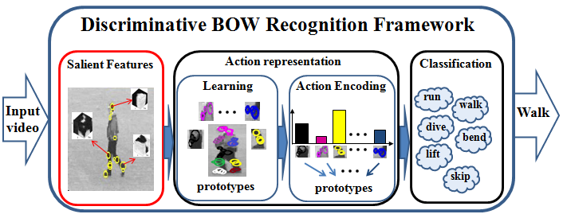
OVERALL DIAGRAM

Slide 9
Existing system
EXISTING TECHNIQUE:
Bag of Words –Applied to image classification by treating image features aas words. BoF was derived from the Bag of Words (BoW) model. Used in document classification,where the occurrence of each word is used as a feature for training a clssifier.
DRAWBACK:
Key points extract from is not such easy task.
The data’s size and complexity and the variability in content and format between different providers, data types and care settings will create huge challenges.

Slide 10
Proposed system
The proposed food recognition system consists of two stages; food image description and image classification
This set provides input to the second stage, where a classifier assigns to the image one class out of a pre-defined set of food classes.
A set of characteristics representing the visual content of the image is extracted and quantified.
Web service composition enables seamless and dynamic integration of business applications on the web.

Slide 11
Proposed system
The performance of the composed application is determined by the performance of the involved web services.
Therefore, non-functional, quality of service(QoS) aspects (e.g. response time, availability, etc.) is crucial for selecting the web services to take part in the composition.
The problem of identifying the best candidate web services from a set of functionally-equivalent services is a multi-criteria decision making problem.
The selected services should optimize the overall QoS of the composed application, while satisfying all the constraints specified by the client on individual QoS parameters.

Slide 12
Proposed system
PROPOSED ALGORITHM:-
𝑘-means clustering algorithm
ALGORITHM DEFINITION:-
𝑘-means is considered to be one of the best clustering techniques, its high computational complexity significantly increases the processing time of the dictionary learning, while the large number of clusters produced slows down the descriptors’ quantization

Slide 13
HARDWARE AND SOFTWARE REQUIREMENTS
HARDWARE REQUIREMENTS
The hardware requirements may serve as the basis for a contract for the implementation of the system and should therefore be a complete and consistent specification of the whole system. They are used by software engineers as the starting point for the system design. It should what the system do and not how it should be implemented.
Processor : Pentium Dual Core 2.00GHZ
Hard disk : 40 GB
Mouse : Logitech.
RAM : 2GB(minimum)
Keyboard : 110 keys enhanced.

Slide 14
HARDWARE AND SOFFTWARE REQUIREMENTS
SOFTWARE REQUIREMENTS
The software requirements document is the specification of the system. It should include both a definition and a specification of requirements. It is a set of what the system should do rather than how it should do it. The software requirements provide a basis for creating the software requirements specification. It is useful in estimating cost, planning team activities, performing tasks and tracking the teams and tracking the team’s progress throughout the development activity.
Operating system : Windows7
IDE : Microsoft Visual Studio .Net 2010
Front End : WPF
Coding Language : C#
Backend : SQL Server 2008

Slide 15
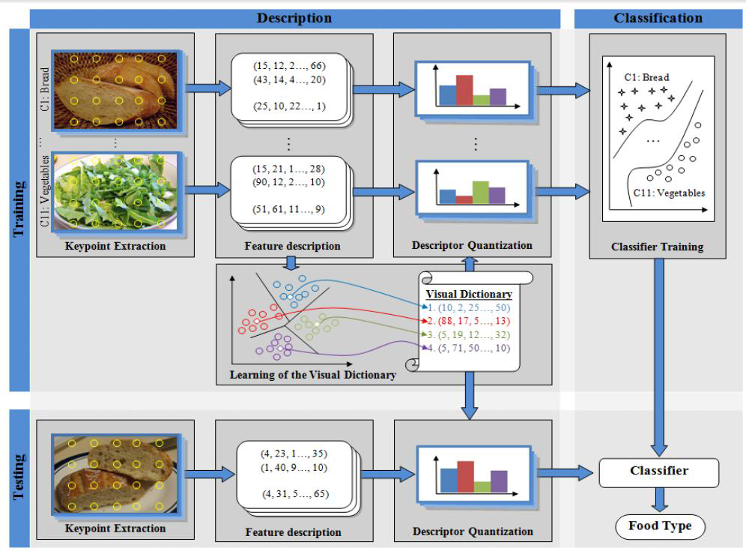
ARCHITECTURE DIAGRAM

Slide 16
algorithm
Randomly choose k data items from X as intial centroids.
Repeat,
Assign each data point to the clustter which has the closest centroid
calculate new clustter centroids
Untill the convergence criteria is met.
Relatively efficient:O(tkn),where n is #objects, k is #clustters, and t is #iterations,.Normally k,t<<n.
Often terminates at a local optimum

Slide 17
START
NO.OF CLUSTTER K
CENTROID
DISTANCE OBJECTS TO CENTROIDS
NO OBJECT MOVE GROUP?
END
GROUPING BASED ON MINIMUM DISTANCE

Slide 18
ALGORITHM
In the current study, three different key point extraction methods were tested:
interest point detectors,
random sampling and
dense sampling.
Interest point detectors, such as SIFT are considered as the best choice for image matching problems where a small number of samples is required, as it provides stability under local and global image perturbations.

Slide 19
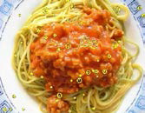
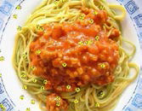
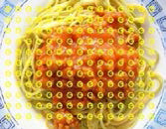
Sift, dense sampling and random sampling

Slide 20
Novelty of the project
Bag of features model is used.
k-means clustering algorithm is used which is very efficient and consumes less time to process.

Slide 21
Module name
AUTHENTICATION
DATASET PREPROCESSING.
KEYPOINT EXTRACTION.
FEATURE DESCRIPTION.
DESCRIPTOR QUANTIZATION
IMAGE CLASSIFICATION

Slide 22
MODULE DESCRIPTION & MODULE DIAGRAM
SENDER:
Authentication:
In authentication module is used to checking the user as valid or invalid.
In this module enter the username and password, this username and password is check into the database.
If username and password is correct then allow to next processing, otherwise it consider as invalid user and again go to the login process.

Slide 23
If No
Is Genuine or Fake?
Login Credentials
Service Consumption
If Yes
RDBMS

Slide 24
MODULE DESCRIPTION & MODULE DIAGRAM
DATASET PREPROCESSING
In this module we describe the image dataset that it is contain various types of food images.
The overall goal of the task is to collecting multi-modal images approaches that combine textual and visual evidence in order to satisfy a user’s multimedia information need could deal with larger scale image collections that contain highly heterogeneous items both in terms of their textual descriptions and their visual content.
The aim is to simulate image retrieval in a realistic setting, such as the Web environment

Slide 25
Image dataset
Check file extensions
Click to retrieve images
Various types of food images

Slide 26
MODULE DESCRIPTION & MODULE DIAGRAM
KEYPOINT EXTRACTION
Key points are selected points on an image that define the centers of local patches where descriptors will be applied.
In the current study, three different key point extraction methods were tested: interest point detectors, random sampling and dense sampling.
Interest point detectors, are considered as the best choice for image matching problems where a small number of samples is required, as it provides stability under local and global image perturbations.

Slide 27
Food Image dataset
Various food images
Select image from dataset
Upload image
Select key points from
Key point extraction

Slide 28
MODULE DESCRIPTION & MODULE DIAGRAM
FEATURE DESCRIPTION:
A local image descriptor is applied to a rectangular area around each key point to produce a feature vector.
Identifying the appropriate descriptor size and type for a recognition problem is a challenging task that involves a number of experiments.

Slide 29
Selected food image
Key point’s selection
From image
Applying rectangular area
Future vector
Production

Slide 30
MODULE DESCRIPTION & MODULE DIAGRAM
DESCRIPTOR QUANTIZATION
Descriptor quantization is the procedure of assigning a feature vector to the closest visual word of a predefined visual vocabulary.
Once the visual dictionary is learnt, each descriptor of an image is quantized and the histogram of visual word occurrences serves as a global description of the image.
Then, the histogram values are usually scaled to [0 1] and are fed to the classifier either for training or testing.
The efficiency of this part of the system is crucial, since it affects processing times for both training and testing.
The complexity of the descriptor quantization mainly depends on the dimensions of the descriptor and the number of visual words.

Slide 31
Training set
Selected image
Key point extraction
Color histogram
Color descriptors
Descriptor quantization
Visual dictionary classifier
R
G
B

Slide 32
MODULE DESCRIPTION & MODULE DIAGRAM
IMAGE CLASSFICATION
The image classification stage is involved in both training and testing phases.
In order to identify the appropriate classifier for the specific problem, several experiments with three supervised classification methods were conducted.
According to our food type we can those images for further more easy way to retrieving images from classified lists.

Slide 33
Analyze food type
Experimental results
Classifier
Cluster images
Store images

Slide 34
INPUT AND OUTPUT DESIGN
AUTHENTICATION
Input: Username and password
Output: valid or invalid
DATASET COLLECTION
Input: click to choose image files from dataset
Output: view selected image.
KEYPOINT EXTRACTION
Input: choose key points from images
Output: selected key points

Slide 35
INPUT AND OUTPUT DESIGN
FEATURE DESCRIPTION
Input: choose image
Output: classify RGB values
IMAGE CLASSIFICATION
Input: analyze descriptor values to food type
Output: cluster images & stored

Slide 36
SYSTEM DESIGN
Client send the health information to the trusted authority and trusted authority receive the client sending information’s.
After received the files trusted authority generate the public and secrete key for encrypting and decrypting purpose and distribute that keys to the client and server, this keys are receive the client and server.
In the server side use this key and decrypt the receive file and transmit to the client, then client decrypt the received file and get the original files.

Slide 37
RGB values update:
public bool RGB_update(Bo_class bo)
{
con = new SqlConnection(connection);
con.Open();
cmd = new SqlCommand("RGB_update", con);
cmd.CommandType = CommandType.StoredProcedure;
cmd.Parameters.AddWithValue("@R",bo.R_value1);
cmd.Parameters.AddWithValue("@G", bo.G_value1);
cmd.Parameters.AddWithValue("@B",bo.B_value1);
cmd.Parameters.AddWithValue("@name",bo.Img_name1);
value=cmd.ExecuteNonQuery();
if(value>0)
{
return true;
}
else
{
return false;
}
}

Slide 38
Training datset:
public bool Training_dst(Bo_class bo)
{
con = new SqlConnection(connection);
con.Open();
cmd = new SqlCommand("Training_dst", con);
cmd.CommandType = CommandType.StoredProcedure;
cmd.Parameters.AddWithValue("@R", bo.R_value1);
cmd.Parameters.AddWithValue("@G", bo.G_value1);
cmd.Parameters.AddWithValue("@B", bo.B_value1);
cmd.Parameters.AddWithValue("@name", bo.Img_name1);
cmd.Parameters.AddWithValue("@food_type", "Diabetes");
value = cmd.ExecuteNonQuery();
con.Close();
if (value > 0)
{
return true;
}
else
{
return false;
}
}

Slide 39
Visual dictionary analysis
public List<string> Visual_dict(Bo_class bo)
{
List<string> lst = new List<string>();
con = new SqlConnection(connection);
con.Open();
cmd = new SqlCommand("Visual_analysis", con);
cmd.CommandType = CommandType.StoredProcedure;
cmd.Parameters.AddWithValue("@R", bo.R_value1);
cmd.Parameters.AddWithValue("@G", bo.G_value1);
cmd.Parameters.AddWithValue("@B", bo.B_value1);
sdr = cmd.ExecuteReader();
int v = sdr.GetOrdinal("Food_Type");
while (sdr.Read())
{
if (!lst.Contains(sdr[value].ToString()))
{
lst.Add(sdr[value].ToString());
}
}
con.Close();
cmd.Dispose();
return lst;
}

Slide 40
Image clustering:
public bool Cluster_data(Bo_class bo)
{
con = new SqlConnection(connection);
con.Open();
cmd = new SqlCommand("update_details", con);
cmd.CommandType = CommandType.StoredProcedure;
cmd.Parameters.AddWithValue("@name", bo.Img_name1);
foreach(string a in bo.Values)
{
cmd.Parameters.AddWithValue("@disease_name",a);
}
value = cmd.ExecuteNonQuery();
con.Close();
if (value > 0)
{
return true;
}
else
{
return false;
}
}

Slide 41
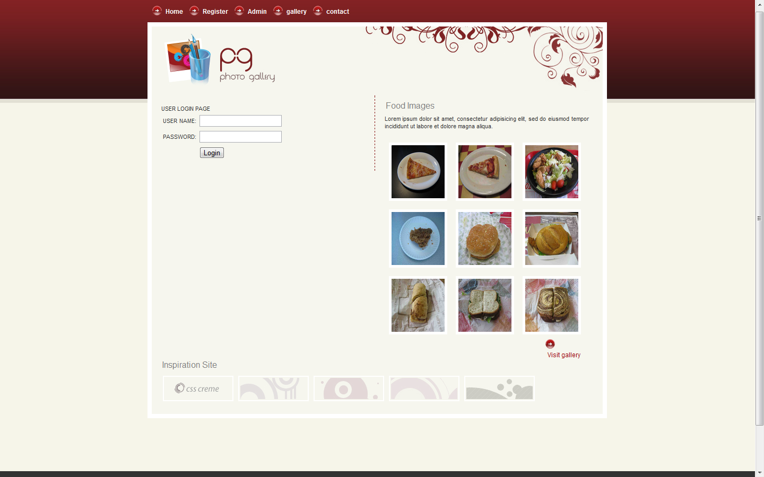
SNAPSHOTS
HOME:

Slide 42
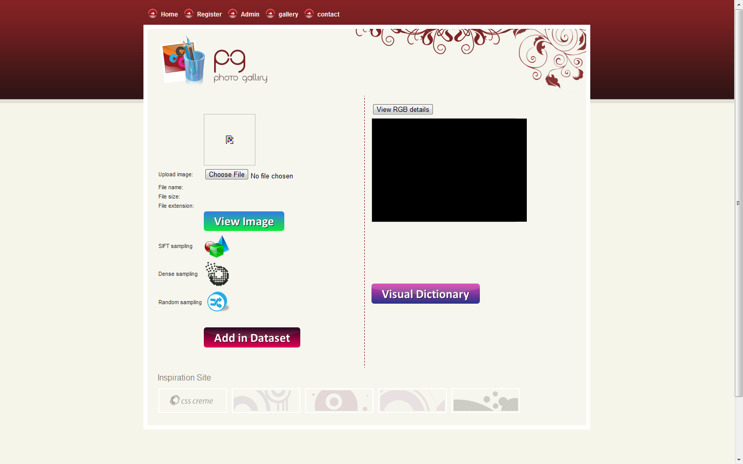
ADMIN WORK PAGE:

Slide 43
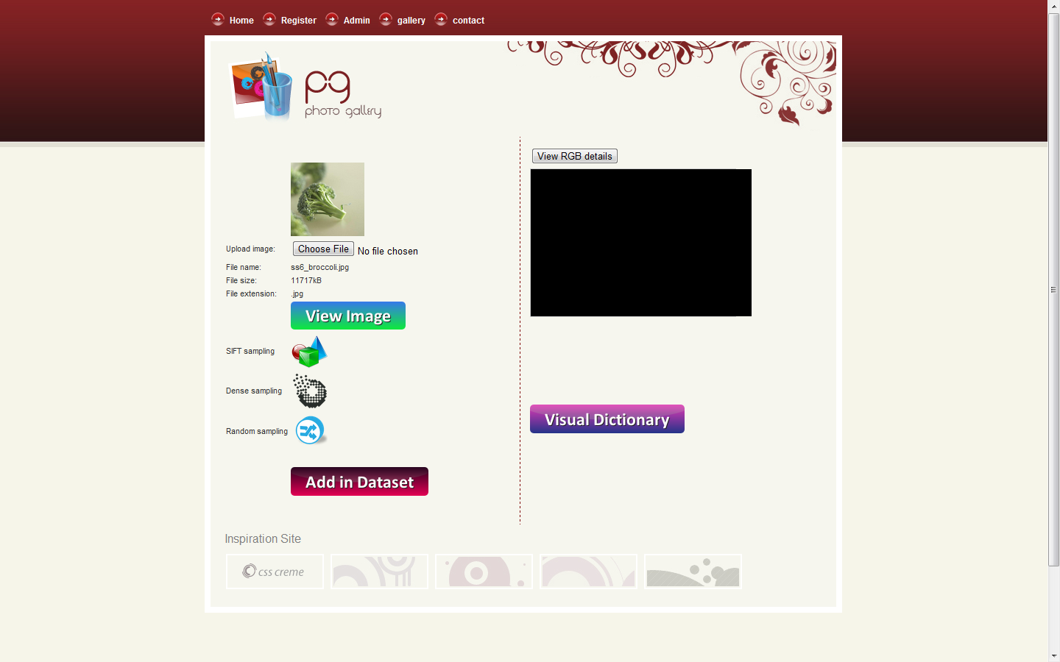
UPLOAD IMAGES:

Slide 44
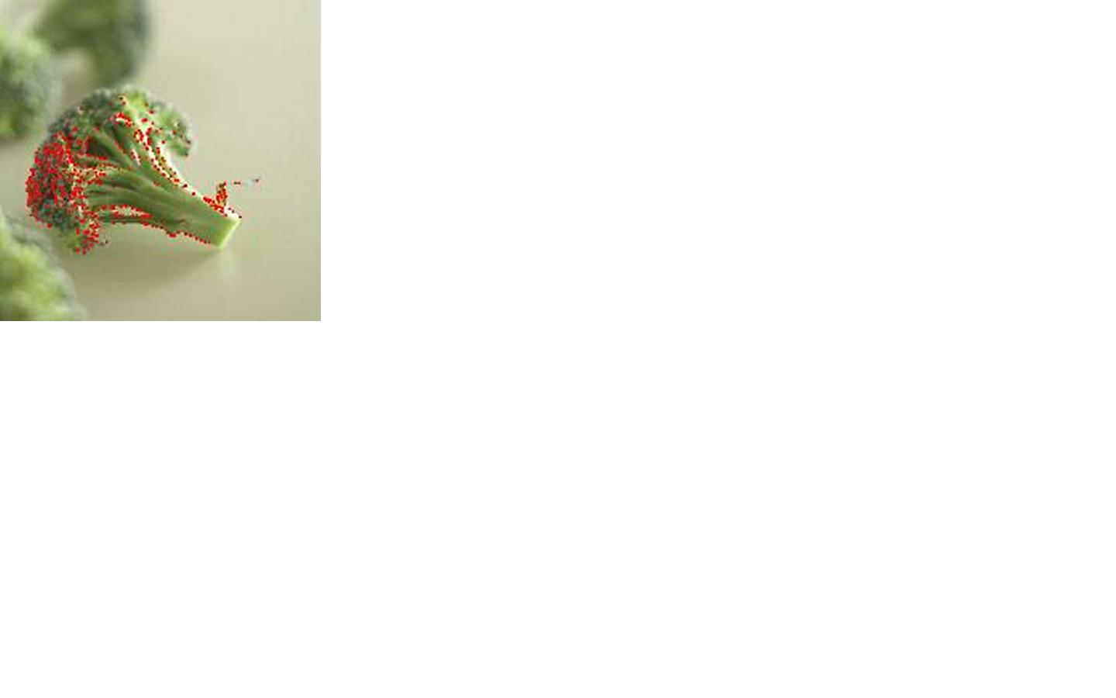
MODULE 3: KEY POINT EXTRACTION
SIFT sampling technique:
The above fig shows the design for SIFT sampling technique which will use to key point extraction.
KEYPOINT EXTRACTION
Input: choose key points from images
Output: selected key points

Slide 45
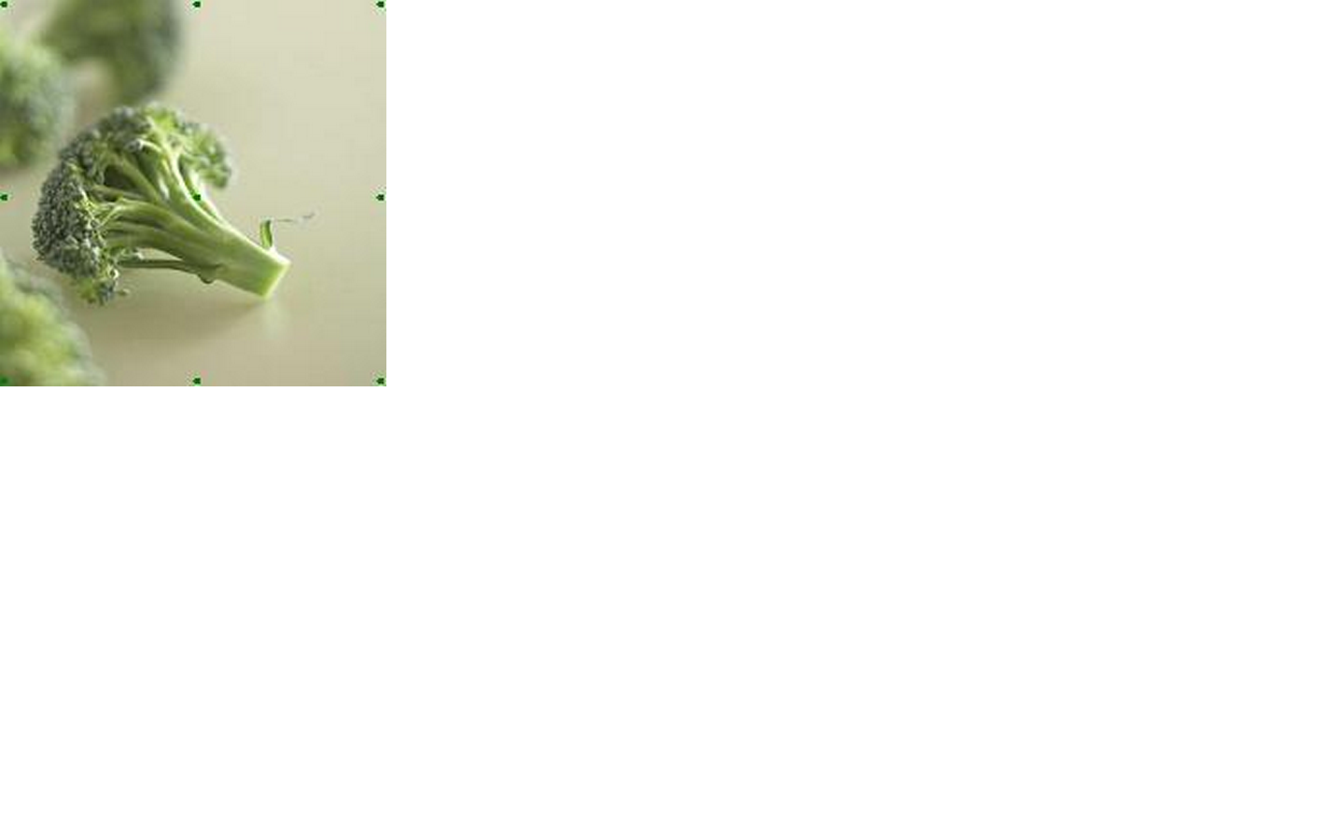
DENSE sampling technique:
The above fig shows the design for DENSE sampling technique which will use to key point extraction.
KEYPOINT EXTRACTION
Input: choose key points from images
Output: selected key points

Slide 46
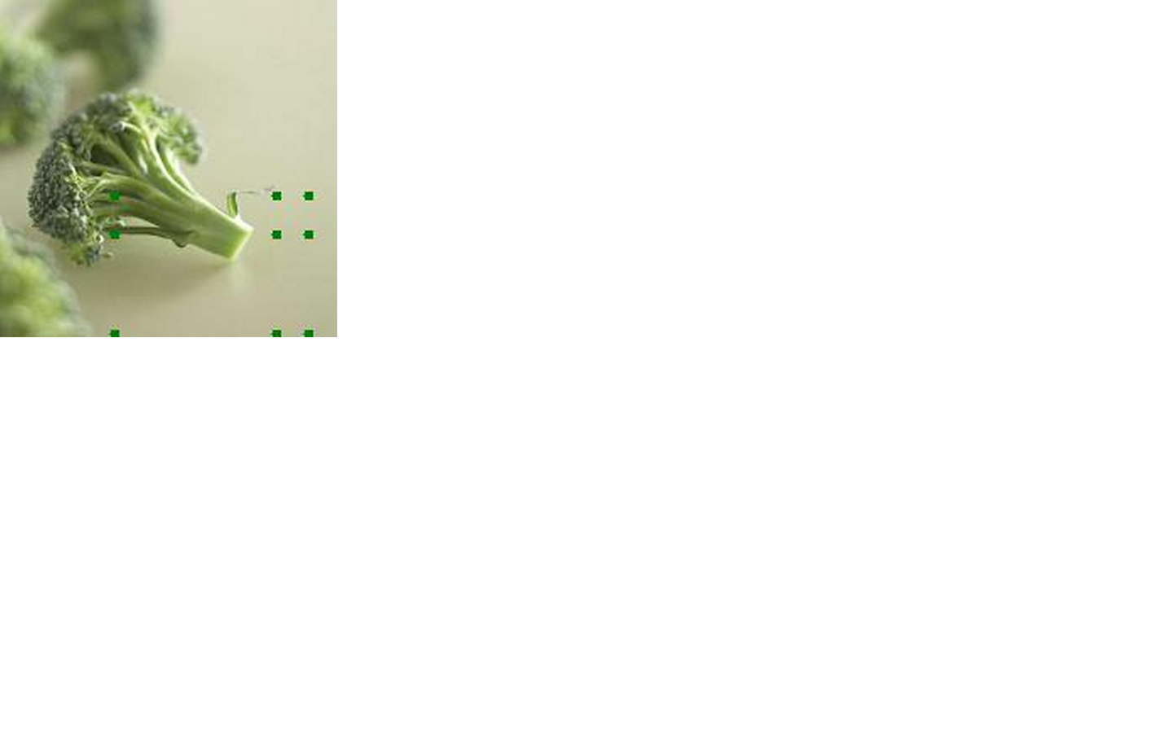
RANDOM sampling technique:
The above fig shows the design for RANDOM sampling technique which will use to key point extraction.
KEYPOINT EXTRACTION
Input: choose key points from images
Output: selected key points

Slide 47
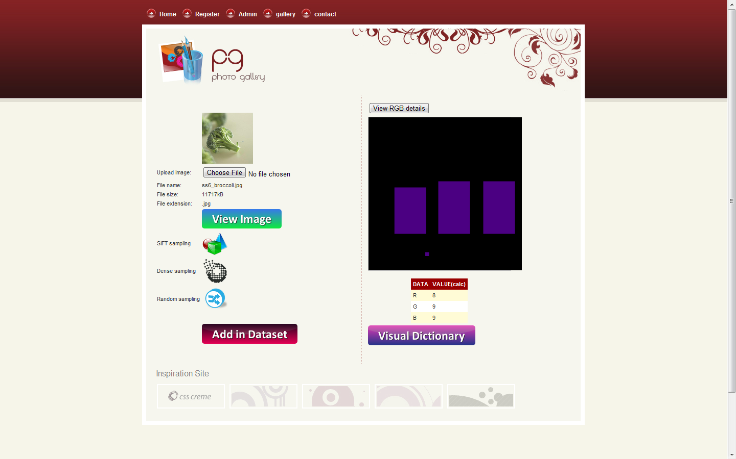
MODULE 3.1: FEATURE DESCRIPTION
RGB values:
The above fig shows the design for feature description details; it contains the details about RGB values about uploaded images.
FEATURE DESCRIPTION
Input: choose image
Output: classify RGB values

Slide 48
MODULE 4: DESCRIPTOR QUANTIZATION
RGB values probability:
The above fig shows the design for RGB values probability from uploaded images in table view. It contains data, values in percentage view.
DESCRIPTOR QUANTIZATION
Input: analyze descriptor values to food type
Output: visual dictionary analysis.

Slide 49
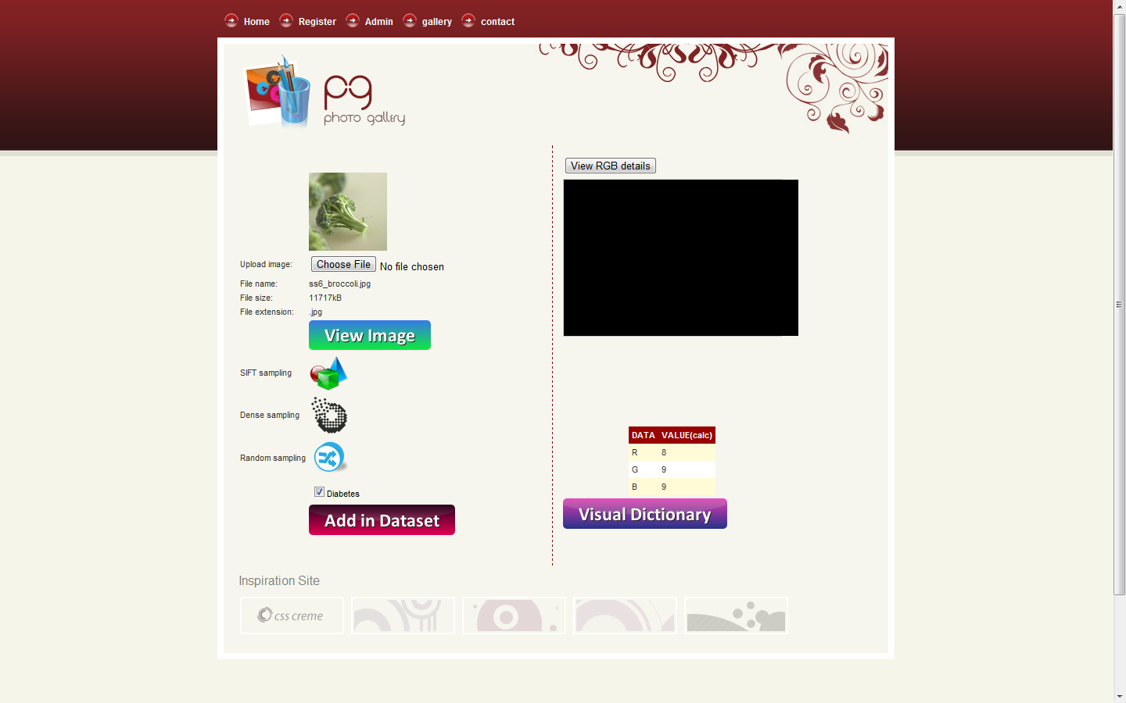
MODULE 5: IMAGE CLASSIFICATON
Identifying food content:
The above fig shows the design for identifying food image content which will match to predefined food list contents.
IMAGE CLASSIFICATION
Input: analyze descriptor values to food type
Output: cluster images & stored

Slide 50
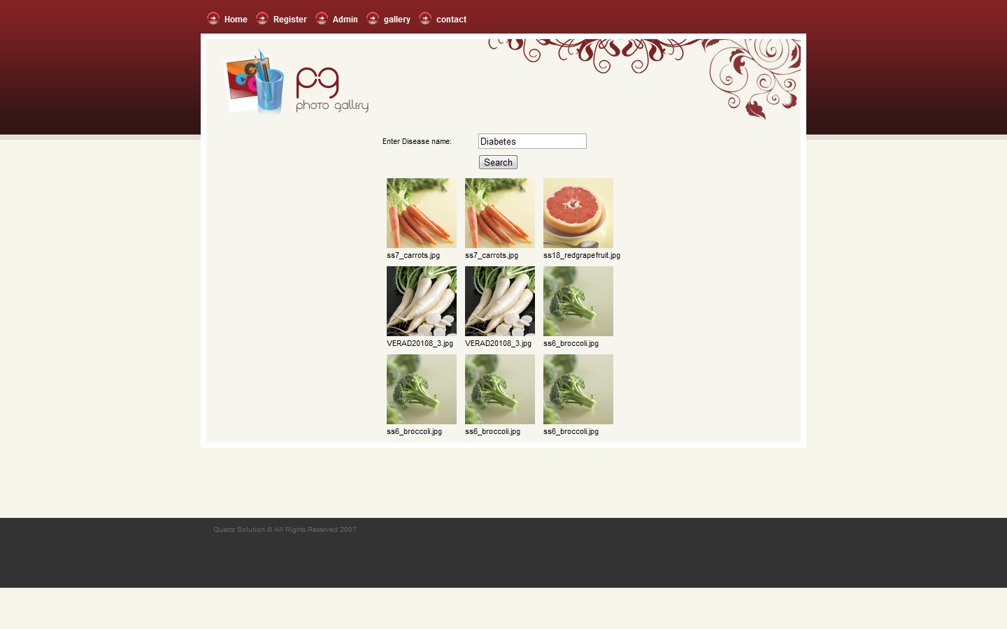
Food images result:

Slide 51
Apply Rating:
The above fig shows the design apply rating on particular image.
APPLY RATING:
Input: choose image
Output: apply rating to particular images.

Slide 52
REFERENCES
[1] American Diabetes Association, “Standards of medical care in diabetes-2010,” Diabetes
[2] C. E. Smart, K. Ross, J. A. Edge, C. E. Collins, K. Colyvas, and B. R. King, “Children and adolescents on intensive insulin therapy maintain postprandial glycaemic control without precise carbohydrate counting,” Diabetic Medicine.
[3] C. E. Smart, B. R. King, P. McElduff, and C. E. Collins, “In children using intensive insulin therapy, a 20‐g variation in carbohydrate amount significantly impacts on postprandial glycaemia,” Diabetic Medicine,
[4] M. Graff, T. Gross, S. Juth, J. Charlson, “How well are individuals on intensive insulin therapy counting carbohydrates?,” Diabetes Research and Clinical Practice,
[5] F. K. Bishop, D. M. Maahs, G. Spiegel, D. Owen, G. J. Klingensmith, A. Bortsov, J. Thomas, and E. J. Mayer-Davis, “The carbohydrate counting in adolescents with type 1 diabetes (CCAT) study,” Diabetes Spectrum.

Slide 53
[6] C.E. Smart, K. Ross, J.A. Edge, B.R. King, P. McElduff, C.E. Collins, “Can children with type 1 diabetes and their caregivers estimate the carbohydrate content of meals and snacks?” Diabetic Medicine.
[7] O. Amft, G. Tröster, “Recognition of dietary activity events using on-body sensors,” Artificial Intelligence in Medicine,
[8] G. Shroff, A. Smailagic, and D. P. Siewiorek, “Wearable context-aware food recognition for calorie monitoring,” in 12th IEEE International Symposium on Wearable Computers,
[9] F. Zhu, M. Bosch, I. Woo, S. Y. Kim, C. J. Boushey, D. S. Ebert, and E. J. Delp, “The use of mobile devices in aiding dietary assessment and evaluation,” IEEE Journal of selected Topics in Signal Processing
[10] F. Kong and J. Tan, “DietCam: Automatic dietary assessment with mobile camera phones,” Pervasive and Mobile Computing.

Slide 54
[11] J.N. Matthews, W. Hu, M. Hapuarachchi, T. Deshane, D. Dimatos, G. Hamilton, M. McCabe, and J. Owens, “Quantifying the Performance Isolation Properties of Virtualization Systems,” Proc. Workshop Experimental Computer Science (ExpCS ’07), 2007.
[12] Amazon Elastic Compute Cloud,2012.
[13] D. Milojicic, I.M. Llorente, and R.S. Montero, “Opennebula: A Cloud Management Tool,” IEEE Internet Computing, vol. 15, no. 2, pp. 11-14, Mar./Apr. 2011.
[15] S. Boyd and L. Vandenberghe, Convex Optimization. Cambridge Univ. Press, 2009.
[16] E. Imamagic, B. Radic, and D. Dobrenic, “An Approach to Grid Scheduling by Using Condor-G Matchmaking Mechanism,” Proc. 28th Int’l Conf. Information Technology Interfaces,

Slide 55
THANK YOU

